Slide 1
Capstone project
INVENTORY_MANAGEMENT - PYTHON
Submitted By – Pratham Joya

Slide 2
Introduction
Inventory Management will help to keep records of all the assets assigned to employees.
Manage inventory and employees

Slide 3


USE case diagram,
Login/Logout
Add/Remove emp
Add/Delete items
Admin
Assign/Unassign items
See details
Login/logout
employee
See_assigned_items
Use Case Diagram for inventory management

Slide 4
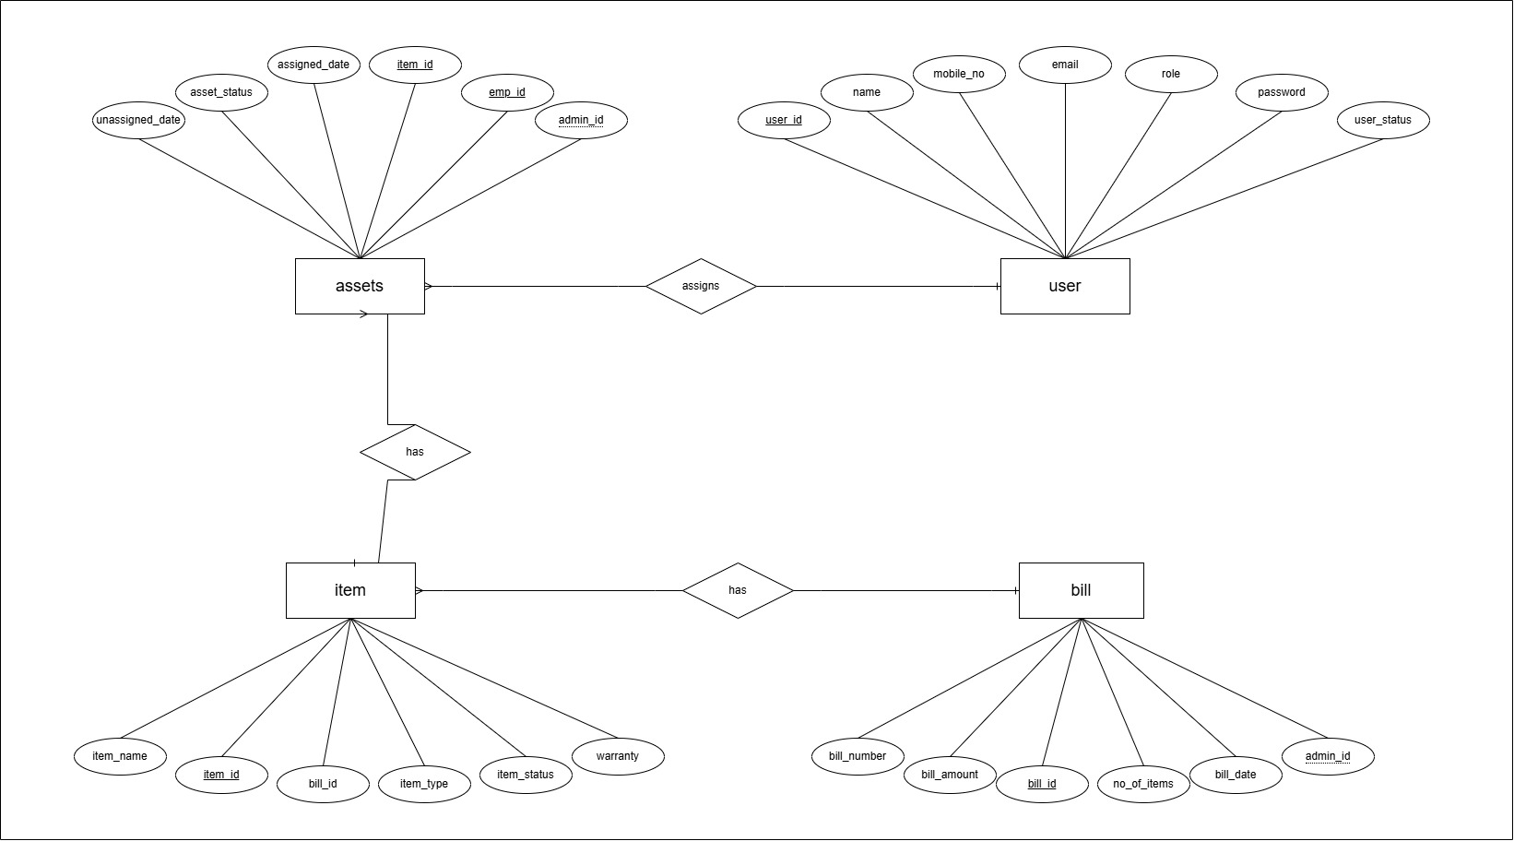
ER DIAGRAM

Slide 5
Technologies used
Frontend – HTML , CSS , JavaScript
Backend – Python(Flask, SQL Alchemy)
Database – MySQL
Development Platform – Pycharm

Slide 6
THANKYOU

